Slide 1
Obtaining Elemental Tissue Composition of Proton Therapy Patients using PET : A Pilot Study AAPM 2012, Charlotte, NC
Jongmin Cho, Geoffrey Ibbott, Michale Gillin, Carlos Gonzalez-Lepera and Osama Mawlawi
UT MD Anderson Cancer Center
Notes:
PET imaging for proton therapy verification.
Please interrupt me anytime for questions.

Slide 2
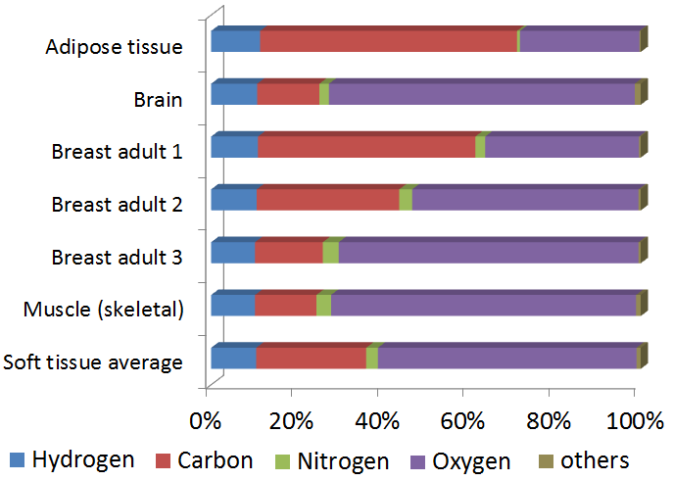
Limitations of CT based proton planning
Stopping power = f (electron density, atomic # Z)
Tissue elemental composition difference ignored for proton planning -> dose and range uncertainties
HU: -50
HU: +40
HU: -30
HU: +50

Slide 3
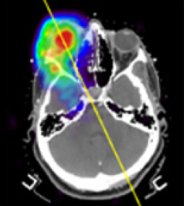
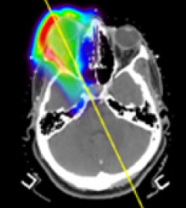
Limitations of Proton Treatment Verification using PET
Zhu et. al.
2011
Vitreous
humour
Measured
5 min PET
Monte Carlo
5 min PET
No accurate elemental tissue composition
provided for Monte Carlo simulation
Notes:
Limitations of treatment verification.
Currently, treatment verification is done by PET imaging the patient immediately after proton treatment and compare the measured PET with Monte Carlo simulated PET. Compared to Monte Carlo dose simulation, Monte Carlo PET simulation is even more sensitive to the elemental composition of irradiated tissue.
This MC PET simulation is done using a tabulated elemental composition for a given HU and a generic biological washout model. However, you observe quite a lot of difference in the eye. Two possible reasons for this discrepancy is first the eye has much higher oxygen concentration compared to other soft tissue of a similar HU. When oxygen is proton activated, the majority is converted into O15 which decays with 5 min half life. For a short 5 min scan, a tissue with a high oxygen concentration turns out to be hot, however MC PET simulation which did not use the correct elemental composition does not show the hot spot in the eye.
Second, MC simulation was done using a generic biological diffusion model for all soft tissues. However, the eye tissue is enclosed and does not communicate easily with surrounding tissue. Therefore the activation in the eye did not diffuse but Monte Carlo simulation was done with activity diffusion from the eye.
Even the proton range verification has a limitation as you can see from this graph.
While the dose is high up to the very end of the proton range, the corresponding activity falls off too quickly even before reaching the end.
If we add biological diffusion, it will be even more difficult to estimate the proton range from tissue activation.
All these tissue activations decay quite quickly, so we need a in-room or even in-beam PET scanner which can be quite expensive for most proton centers.

Slide 4
Motivation
To provide the elemental tissue composition from proton activation and using PET
Which will improve
Stopping power calculation for more accurate proton planning
Proton dose & range verification using PET
Notes:
The first motivation of my research is improving the current way of dose and range calculation as well as verification by providing tissue elemental composition.
The second motivation is on verifying the proton range with implantable dosimeters.
I was looking for some elements that are proton activated very strongly at very low proton energy and decay slowly so that we can observe the activation of these dosimeters as the sign of the proton distal end. By using these implantable dosimeters for proton range verification, we do not have to worry about first, biological diffusion, not activating at the very end of the proton range, also spending big bucks for in-room PET scanner.

Slide 5
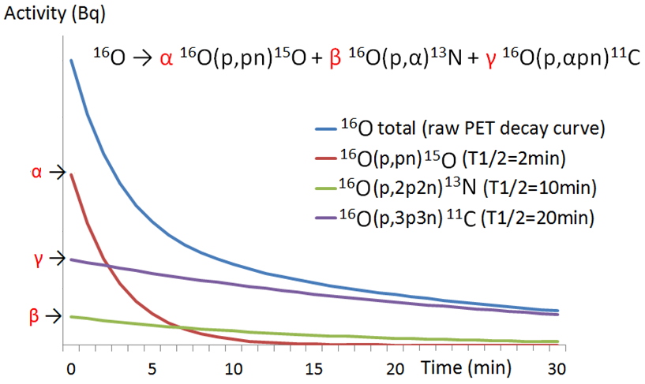
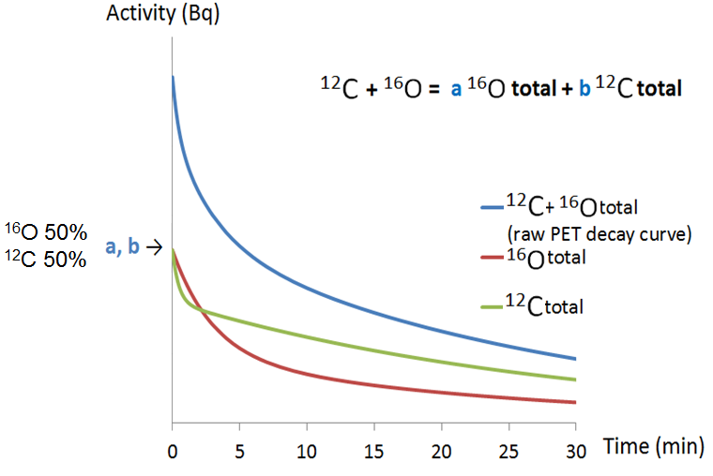
Method: Tissue Element Decomposition
mixed
Notes:
So activated O-16’s decay curve can be measured using a PET as shown as raw PET decay curve here.
Using the least squares method, this decay curve can be separated into three simple exponential decay curves of O-15, N13, and C-11.
From this separation, we determine the magnitude of alpha, beta, and gamma. This alpha, beta, and gamma will change with depth since proton energy changes with depth.

Slide 6
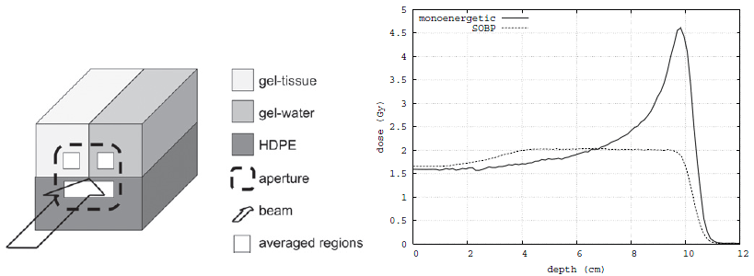
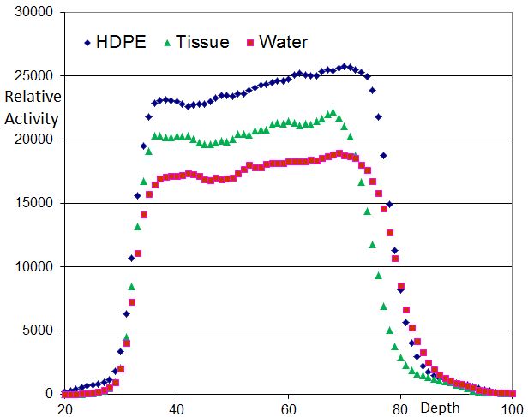
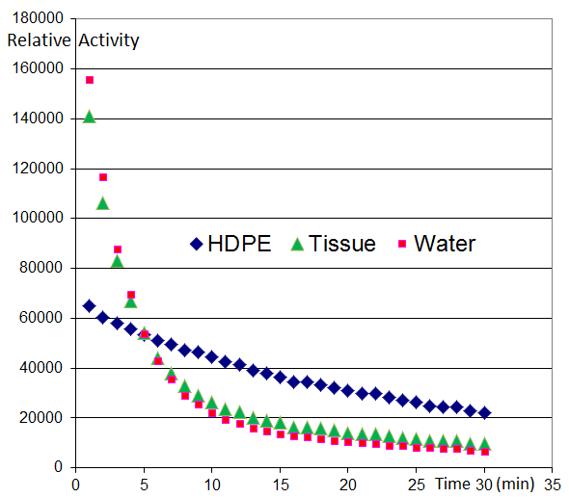
Materials & Methods
Espana et. al.
Raw
PET data
Raw
PET data

Slide 7
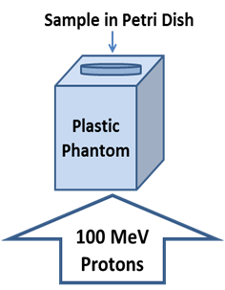
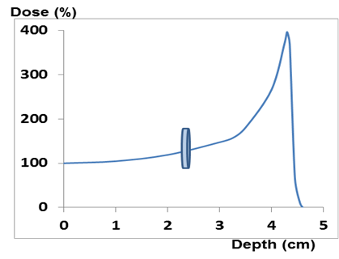
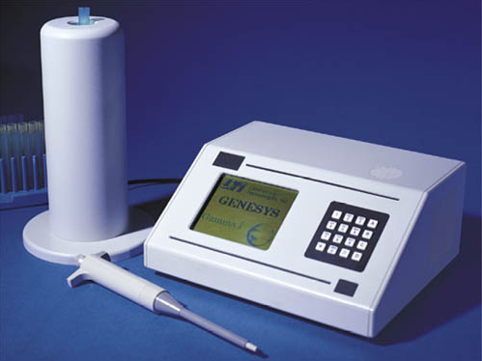
Materials & Methods
6 samples irradiated
C only
O only
C+O
C+N
O+N
C+O+N
Gamma counter used to measure time decay after ~ 5 min delay

Slide 8
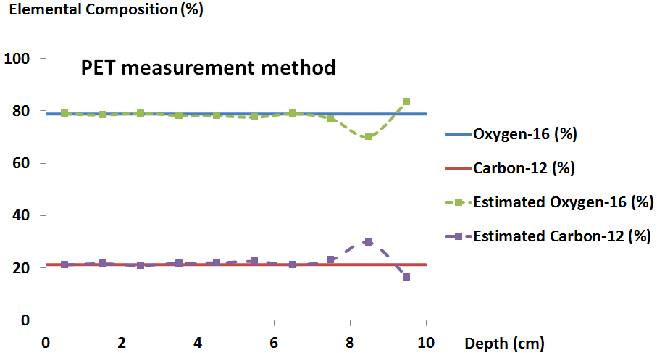
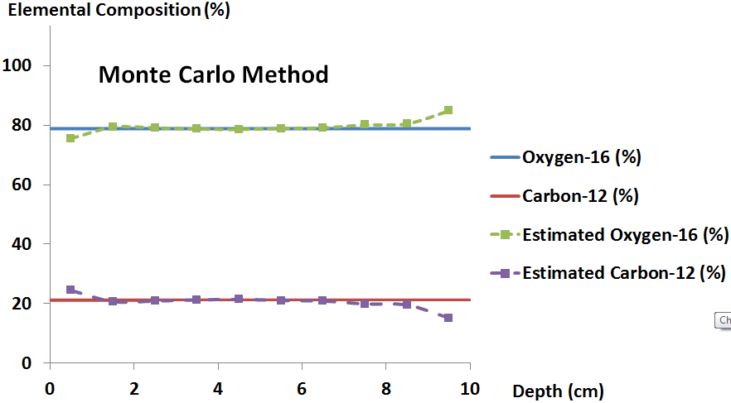
Results
116 MeV monoenergetic beam
116 MeV SOBP beam: Similar results obtained

Slide 9
Results
Larger errors are due to…
Longer decay (~ 5 min).
Non simultaneous irradiation.
Pure N14 sample not available.

Slide 10
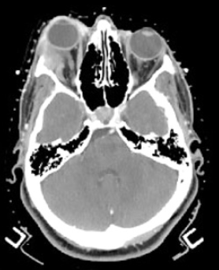
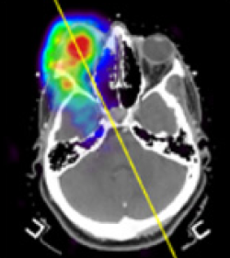
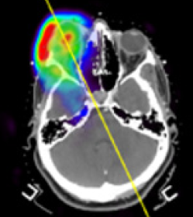
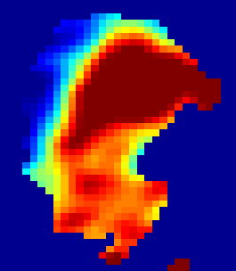
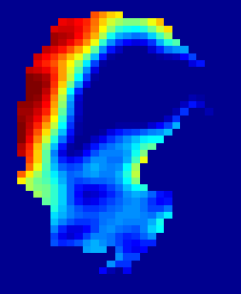
Result
 | Estimation (%) |  | ICRU 46 (%)
 | C-12 | O-16 | C-12 | O-16 | Uncertainty (%)
Vitreous humour | 0 | 100 | 1.5 | 98.5 | 1.5
Adipose/mask | 74.7 | 13.2 | 68.1 | 19.8 | 50
Optic nerve | 13.9 | 73.2 | 14.5 | 71.2 | 9
Brain | 13.4 | 73.7 | 14.5 | 71.2 | 8
Zhu et. al.
Oxygen
concentration
Carbon
concentration
5 min PET scan
30 min PET scan

Slide 11
Conclusion
Estimated elemental composition of C-12 and O-16 within 5%/10% uncertainties for mono/SOBP proton beams in the phantom using an in-room PET.
Monte Carlo method simplified phantom element decomposition process.
Patient PET data was decomposed to estimate C-12 and O-16 composition with reasonable uncertainties.

Slide 12
Acknowledgement
MGH
Chul Hee Min
Harold Paganetti
Georges El Fakhri
Xuping Zhu
MD Anderson Cancer Center
Uwe Titt
Mitchell Carroll
Kevin Vredevoogd
Kevin Casey
Lawrence Bronk
Pablo Yepes at Rice University and Pedro Arce at Ciemat.
The author contact: jcho2@mdanderson.org

Slide 13
Thank you.

